Slide 1
What we learned about Cassandra while building go90 ?
Chris Webster
Thomas Ng

Slide 2
1 | What is go90 ?
2 | What do we use Cassandra for ?
3 | Lessons learned
4 | Q and A

Slide 3
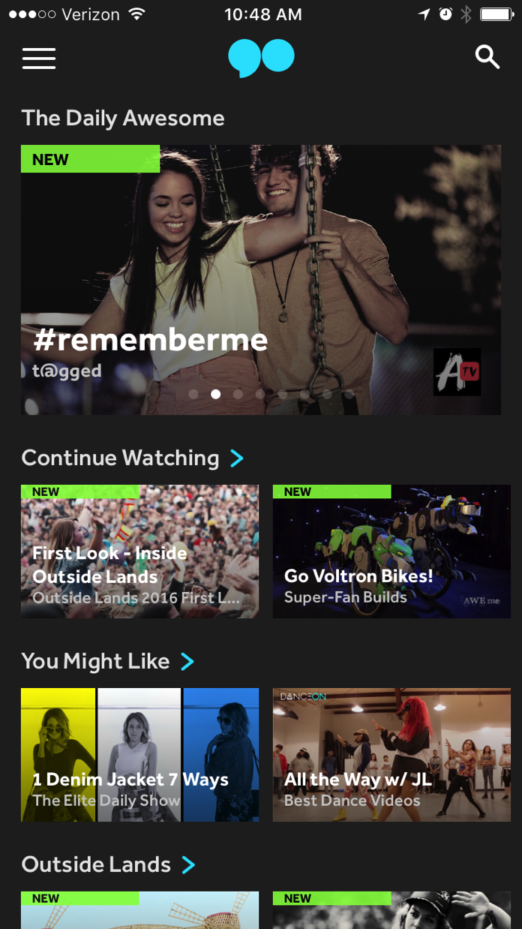
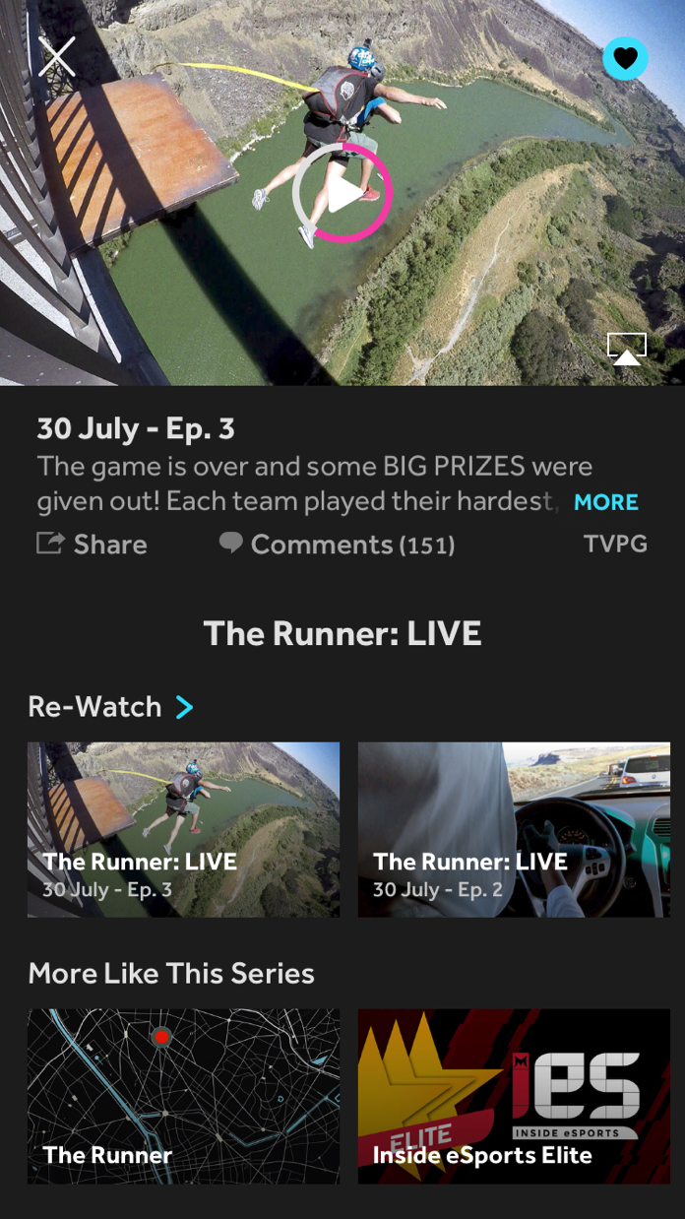
What is go90 ?
Mobile video entertainment platform
On demand original content
Live events ( NBA / NFL / Soccer / Reality Show / Concerts)
Interactive and Social

Slide 4
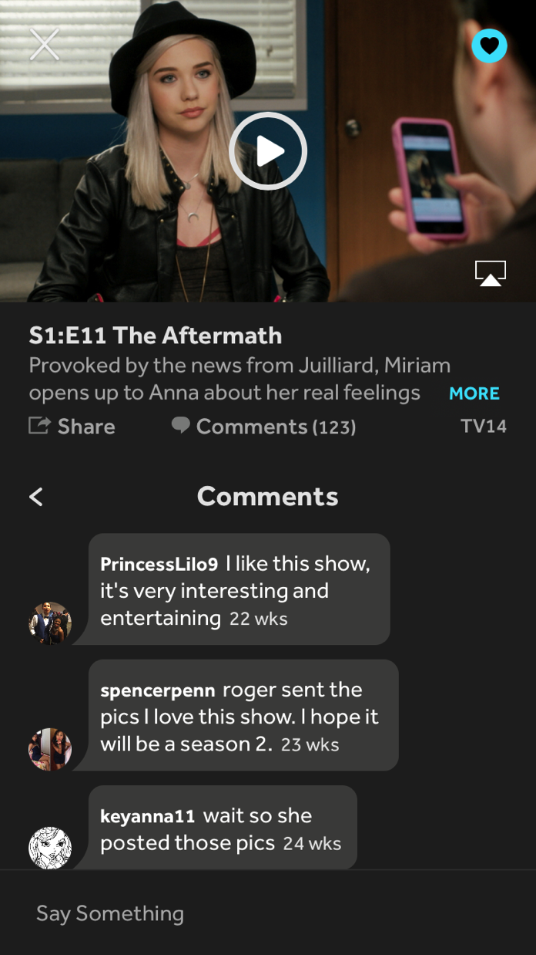
What do we use Cassandra for ?
User metadata storage and search
Schema evolution
DSE cassandra/solr integration
Comments
Time series data
Complex pagination
Counters
Resume point
Expiration (TTL)

Slide 5

What do we use Cassandra for ?
Activity / Feed
Activity aggregation
Fan-out to followers
User accounts/rights
Service management
Content discovery

Slide 6
go90 Cassandra setup
DSE 4.8.4
Cassandra 2.1.12.1046
Java driver version 2.10
Native Protocol v3
Java 8
Running on Amazon Web Services EC2
c3/4 4xlarge instances
Mission critical service on own cluster
Shared cluster for others
Ephemeral ssd and encrypted ebs

Slide 7
Lessons learned

Slide 8
Schema evolution
Use case: Add new column to table schema
Existing user profile table:
Primary key: pid (UUID)
Columns: lastName, firstName, gender, lastModified
Deployed and running in production
Lookup user info with prepared statement:
Query: select * from user_profile where pid = ‘some-uuid’;
Add new column for imageUrl
Service code change to extract new column from ResultSet in existing query above
Apply schema change to production server
alter table user_profile add imageurl varchar;
Deploy new service
No down time at all !?

Slide 9
Avoid SELECT * !
Prepared statement running on existing service with the old schema might start to fall as soon as new column is added:
Java driver could throw InvalidTypeException at runtime when it tries to de-serialize the ResultSet
Cassandra’s cache of prepared statement could go out-of-sync with the new table schema
https://support.datastax.com/hc/en-us/articles/209573086-Java-driver-queries-result-in-InvalidTypeException-Not-enough-bytes-to-deserialize-type-
Always explicitly specify the fields you need in your SELECT query:
Predictable result
Avoid down time during schema change
More data efficient - only get what you need
Query: select lastName, firstName, imageUrl from user_profile where pid = ‘some-uuid’;

Slide 10
Data modeling with time series data
Use case:
Look up latest comments (timestamp descending) on a video id, paginated
Create schema based on the query you need
Make use of clustering order to do the sorting for you!
Make sure your pagination code covers each clustering key
Different people could comment on a video at the same timestamp!
Or make use of automatic paging support in Java driver

Slide 11
Time series data example
Video id | timestamp | User id | Comment
va_therunner | 1470090047166 | user_t | this is a comment string
va_therunner | 1470090031702 | user_z | Hi there
va_therunner | 1470090031702 | user_t | Yo
va_therunner | 1470090031702 | user_a | Love it!
va_tagged | 1458951942903 | user_b | tagged
va_tagged | 1458951902463 | user_x | go90
va_guidance | 1470090031702 | user_v | whodunit
CREATE TABLE IF NOT EXISTS comments ( videoid varchar, timestamp bigint, userid varchar, comment varchar,
PRIMARY KEY(videoid, timestamp, userid))
WITH CLUSTERING ORDER BY (timestamp DESC, userid DESC);

Slide 12
Pagination example
Video id | timestamp | User id | Comment
va_therunner | 1470090047166 | user_t | this is a comment string
va_therunner | 1470090031702 | user_z | Hi there
va_therunner | 1470090031702 | user_t | Yo
va_therunner | 1470090031702 | user_a | Love it!
va_therunner | 1458951942903 | user_b | tagged
va_tagged | 1458951902463 | user_x | go90
va_guidance | 1470090031702 | user_v | whodunit
// start pagination thru comments table
select ts, uid, comment from comments where vid = 'va_therunner' limit 3;
> Returns first 3 rows
// incorrect second call
select ts, uid, comment from comments where timestamp < 1470090031702 AND vid = 'va_therunner' limit 3;
> Returns “tagged” comment // “Love it!” comment will be skipped
// need to paginate clustering column “user id” too
select ts, uid, comment from comments where timestamp = 1470090031702 AND vid = 'va_therunner' AND uid < 'user_t' limit 3;
> Returns “Love it!”

Slide 13
Counters
Use case:
Display total number of comments for each video asset
Avoid select count (*)!
Built in support for synchronized concurrent access
Use a separate table for all counters (separate from original metadata)
Cannot add counter column to non-counter column family
Sometimes counter value can get out of sync
http://www.datastax.com/dev/blog/whats-new-in-cassandra-2-1-a-better-implementation-of-counters
background job at night to count the table and adjust counter values if needed
Counters cannot be deleted
Once deleted – you will not be able to use the same counter for sometime (undefined state)
Workaround – read value and add negative value (not concurrent safe)

Slide 14
Make use of TTL and DTCS !
Use case:
Storing resume points for every user, and every video they watched
Lookup what is recently watched by a user
Problem:
This can grow fast and might not be scalable! (why store the resume point for a person that only watches one video and leave ?)
Solution:
For resume points and watch history, insert with TTL of 30 days.
Combine it with DateTieredCompactionStragtegy (DTCS)
Best fit: time series fact data, delete by TTL
Help cassandra to drop expired data (sstables on disk) effectively by grouping data into sstables by timestamp.
Can drop whole sstables at once
Less disk read means faster read time

Slide 15
Avoid deletes (tombstones)
Use case:
Activity feed with aggregation support
Problem:
How to group similar activity into one and not show duplicates ?
User follows DreamWorksTV and Sabrina
They publish a new episode for the same series (Songs that stick) at the same time
In user’s feed, we want to show one combined event instead of 2 duplicate events
Feed read needs to be fast – first screen in 1.0 app!

Slide 16
First solution
Two separate tables
Feed table: primary key on (userID, timestamp). Always contains aggregated final view of a user’s feed. Lookup is simple read query on the user id => fast.
Aggregation table: primary key (userID, targetID). For each key, we store the current activity written to feed with it’s timestamp.
Feed update is done async on a background job – which involves:
Read aggregation table to see if there is previous entry
Update aggregation table (either insert or update)
Update feed table, which can be a insert if no previous entry, or a delete to remove previous entry and then insert new aggregated entry.
Feed update is expensive, but is done asynchronously
Feed read is fast since is a simple read
It works - ship it!

Slide 17
Empty feed
Field reports of getting empty feed screen
Can occur at random times

Slide 18
Read timeout and tombstones
Long compaction is happening and causing read timeout
Too many delete operations
Each delete will create a new tombstone
Too many tombstone will cause expensive compaction
It will also significantly slow down read operations because too many tombstones needs to be scanned

Slide 19
How to avoid tombstones ?
Adjust gc_grace_seconds so compaction happen more frequently to reduce number of tombstones
Smaller compaction each time
Node repair should happen more frequently too:
http://docs.datastax.com/en/cassandra/2.0/cassandra/operations/ops_repair_nodes_c.html
New data model and algorithm could help too!
Avoid excessive delete ops if possible!
Make use of TTL and DTCS
In our case, we switched to a write-only algorithm:
aggregation in memory by reading more entries instead
45 days TTL with DTCS
time series fact data, delete by TTL

Slide 20
Search: DSE Solr integration
Real time fuzzy user search
Zero down time to add this feature to existing production cluster
Separate small solr data center dedicated for new search queries only
Existing queries unchanged
Writes into existing cluster will be replicated into solr nodes automatically
DB queries
C*
WebService
App Request
replication
Search request
Solr

Slide 21
Solr index disappearing
While we try to set up this initially – new data written to the original cluster will be available for search, but then entries starts to disappear after a few minutes.
Turns out to be combination of two problems:
Existing bug in DSE 4.6.9 or earlier: Top deletion may cause unwanted deletes from the index. (DSP-6654)
In the solr schema xml – if you are going to index the primary key field in the schema, the field cannot be tokenized. (In our case, we do not need to index the primary key anyway – it’s an UUID and no one is going to search with that from the app)
https://docs.datastax.com/en/datastax_enterprise/4.0/datastax_enterprise/srch/srchConfSkema.html
We fixed solr schema and upgrade to DSE 4.8.4 – and all is well!

Slide 22
DevOps

Slide 23
Upgrade DSE and Java
Upgrade
DSE 4.6 to 4.8 (Cassandra 2.0 to 2.1)
Java 7 to 8
Benchmarks with cassandra-stress
https://docs.datastax.com/en/cassandra/2.1/cassandra/tools/toolsCStress_t.html
Findings
In general, Cassandra 2.1 gives better performance in both read and write.
We discovered minor peak performance degradation when running with Java 8 and Cassandra 2.1
http://docs.datastax.com/en/datastax_enterprise/4.8/datastax_enterprise/install/installTARdse.html

Slide 24
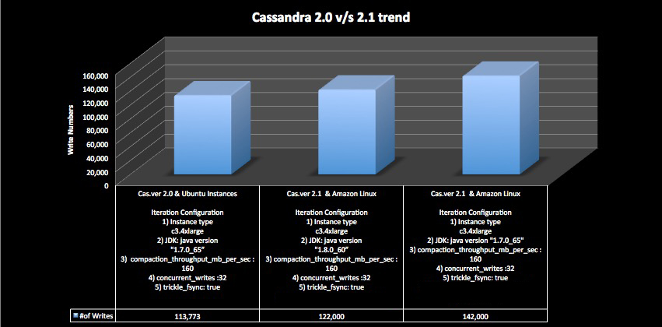

Slide 25
PV or HVM ?
Linux Amazon Machine Images (AMI)
Paravirtual (PV)
Hardware virtual machine (HVM)
http://docs.aws.amazon.com/AWSEC2/latest/UserGuide/virtualization_types.html
HVM gives better performance
Align with Amazon recommendations
Cassandra-stress results:
HVM: ~105K write/s
PV: ~95K write/s

Slide 26
Storage with EC2
Ephemeral (internal) vs Elastic block storage (EBS)
In general, ephemeral gives better performance and is recommended
Internal disks are physically attached to the instance
http://www.datastax.com/dev/blog/what-is-the-story-with-aws-storage
Our mixed mode (read/write) test results:
Ephemeral: 61K ops rate
EBS with encryption: 45K ops rate
But what about when encryption is required ?
EBS has built-in encryption support
http://docs.aws.amazon.com/AWSEC2/latest/UserGuide/EBSEncryption.html
Ephemeral - no native support from AWS, you need to deploy your own solution.

Slide 27
Maintenance
Repairs
Cron job to schedule repair jobs weekly
Full repair on each node
Can take long for big clusters to complete full round
Looking to move to opscenter 6.0.2 with better management interface
Future:
Parallel node repairs
Increment repairs
Backups
Daily backup to S3
Can only restore data since last backup
Future: commit log backup for point-in-time restore

Slide 28

Summary
Avoid SELECT *
Effective data modeling
Make use of TTL and DTCS to avoid tombstones!
Search with SOLR
https://go90.com

Slide 29
Q and A

